Slide 1

August Email Marketing Report
For All Line

Slide 2
Campaign SMART goals & activities
Goal 1: Grow the email subscriber list by 12,000 people by the end of September by partnering with social and paid media specialists and launching an email referral program that offers discounts to existing subscribers.
Goal 2: Increase the monthly conversion rate of current subscribers by 2% within six months of launch by segmenting the email list for the For All line of products.

Slide 3
Campaign KPIs
New subscribers added
Conversion rate
Open rate
Click-to-open rate

Slide 4
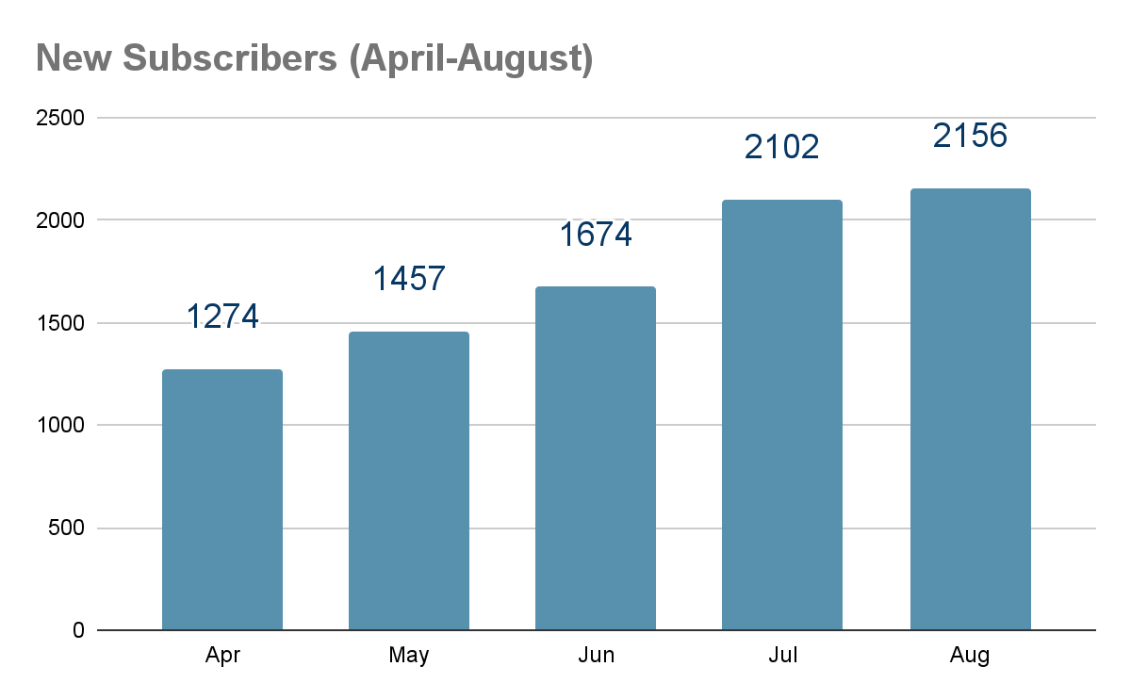
New email subscribers added
Goal
12K new subs by end of Sept.
Gap to target
Aug: 3,337
Launch
Notes:
Summary: Monthly subscriber list growth rate has increased each month since April, but not enough to reach our goal of 12,000 new subscribers by the end of September. The larger jump in subscriber numbers (>400) in July suggests that the publicity around the launch of the For All line may have contributed to the increase. We are still over 3,000 subscribers from our target, so if we continue to add 2,000 new subscribers each month, we will reach our goal in October.
Recommendations: These results suggest that our goal may have been slightly too ambitious. We should meet our target only a couple of weeks late, however, so no specific action is needed. We’ll continue to track new subscriber metrics to determine whether these numbers will continue to increase, hold steady, or return to pre-launch levels.

Slide 5
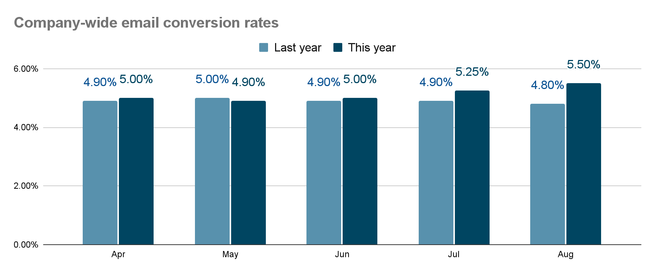
Monthly conversion rates
Goal
Increase 2% by end of Dec.
Launch
Notes:
Summary: The overall conversion rate has increased steadily (a rate of 0.25% in both July and August) since the launch of For All at the end of June. If conversions continue to rise at this rate, we should reach our goal by the end of January (about a month behind schedule).
Recommendations: While email conversions have increased overall since launch, there is still room for improvement. We should try to optimize metrics that can impact the conversion rate, including open rate and click-to-open rate. We need more data to determine whether we can sustain these increases, and will continue to monitor this metric going forward. If conversions decrease or remain steady at 5.50%, we may need to reconsider our overall digital marketing strategy.

Slide 6
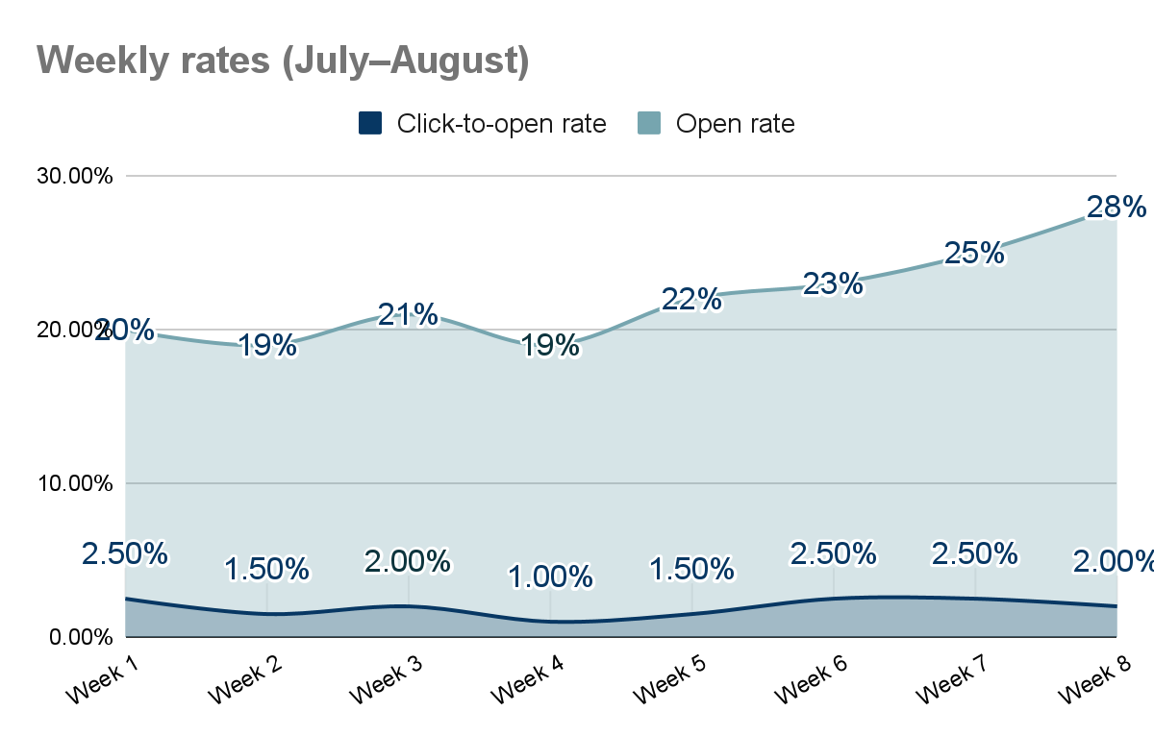
Weekly open rate vs. click-to-open rate
Industry benchmarks
Open rate: 20%
Click-to-open rate: 3%
Notes:
Summary: Our campaign has met the industry benchmark of 20% for email open rates for six out of the last eight weeks. The open rate increased throughout August and reached 28% at the end of the month. The campaign’s click-to-open rate has stayed relatively steady throughout the campaign (between 1.5% and 2.5%), but never reached the industry average. It remained below 3% even when our open rates rose above the 20% benchmark.
Recommendations: It is concerning that click-to-open rates have remained below industry benchmarks, even though open rates are high—and rising. This gap suggests that there is room to improve the campaign open rate. We could run A/B tests with different CTAs or hyperlink positioning. Raising the click-to-open rate would mean more customers visiting our website, which could also help improve the overall conversion rate.

Slide 7
Conclusion and next steps
Campaign performance:
New subscribers increasing naturally post-launch
Rising conversion rates despite CTOR remaining below industry average
Action items include:
Continuing to monitor KPI performance
Run A/B tests to optimize CTOR to increase conversions
Future recommendations:
Evaluate future campaign timeline and goals based on results
Build email lists earlier
Run more pre-campaign A/B tests

